Slide 1
Common Core State Standards for New Mexico & The Next Generation Assessment: Preparing all students for college, career and beyond
Lynn Vasquez
PARCC Program Manager

Slide 2
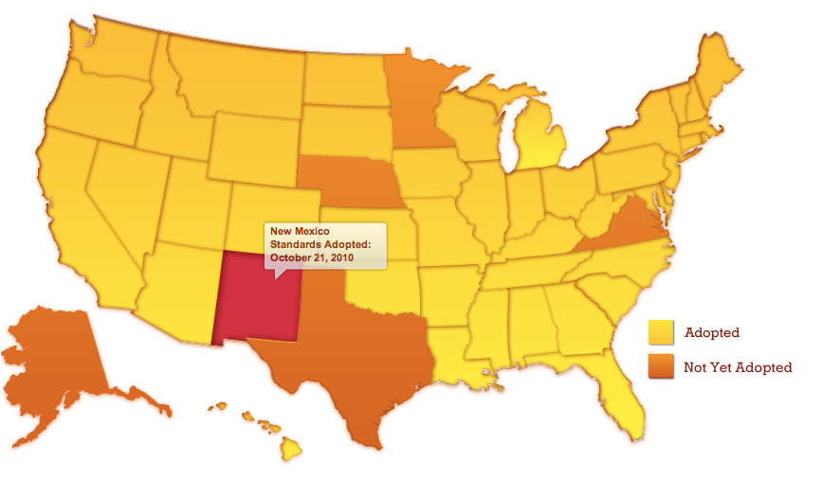
New Mexico is one of 46 states to adopt the CCSS

Slide 3
Why Our Students Need a Common Core:
61% of jobs in New Mexico require a post-secondary degree.
45% of all jobs in the U.S. require 1-2 years of additional training beyond high school.
46.2% of NM students take remedial courses in college within two years after gradation.

Slide 4
The Common Core State Standards provide:
New expectations of skills and knowledge for K – 12 students in Literacy and Mathematics
Teachers the time to go in-depth on objectives, while covering fewer things at each grade level
Parents and communities a pathway for a rigorous curriculum so students are prepared for college and careers

Slide 5
New Expectations for Learning

Slide 6
Shifts in CCSS ELA/Literacy
Building knowledge through content-rich nonfiction
Reading, writing, and speaking grounded in evidence from text, both literary and informational
Regular practice with complex text and its academic language

Slide 7
Why Literacy Shifts Need to Occur:
Informational text makes up vast majority of required reading in college/workplace (80%)
Most college and workplace writing is evidence-based and expository in nature (not narrative)
Too many students reading at too low a level (<50% of graduates can read sufficiently complex texts)

Slide 8
College & Career Ready Lexile Ranges
Notes:
Source: CCSS Standards

Slide 9
Shifts in CCSS Mathematics
Focus: Focus strongly where the standards focus
Coherence: Think across grades, and link to major topics
Rigor: In major topics, pursue conceptual understanding, procedural skill and fluency, and application

Slide 10
Traditional U.S. Approach
 | K 12
Number and Operations
Measurement and Geometry
Algebra and Functions
Statistics and Probability

Slide 11
Focusing Attention within Number and Operations
 | Operations and Algebraic Thinking |  |  |  |  |  |  | Expressions and Equations |  |  |  | Algebra
 |  |  |  |  |  |  | → |  |  |  | →
 | Number and Operations—Base Ten |  |  |  |  |  | → | The Number System
 |  |  |  |  |  |  |  |  |  |  | →
 |  |  |  | Number and Operations—Fractions |  |  | →
 | K | 1 | 2 | 3 | 4 | 5 |  | 6 | 7 | 8 |  | High School
Notes:
Source: Student Achievement Partners

Slide 12
Priorities in Mathematics
Grade | Priorities in Support of Rich Instruction and Expectations of Fluency and Conceptual Understanding
K–2 | Addition and subtraction, measurement using whole number quantities
3–5 | Multiplication and division of whole numbers and fractions
6 | Ratios and proportional reasoning; early expressions and equations
7 | Ratios and proportional reasoning; arithmetic of rational numbers
8 | Linear algebra
Notes:
Source: Student Achievement Partners

Slide 13
Required Fluencies in K-6
Grade | Required Fluency
K | Add/subtract within 5
1 | Add/subtract within 10
2 | Add/subtract within 20 (know single-digit sums from memory) Add/subtract within 100
3 | Multiply/divide within 100 (know single-digit products from memory) Add/subtract within 1000
4 | Add/subtract within 1,000,000
5 | Multi-digit multiplication
6 | Multi-digit division Multi-digit decimal operations

Slide 14
The PARCC Assessment System

Slide 15
SBA Transition to PARCC Timeline for New Mexico
2011-12
2012-13
2013-14
2014-2015
Formation of CCSS Implementation
Team
&
Planning
CCSS Implementation K-3
CCSS Implementation K-12
Current SBA for grades 4-8, 10 & 11
SBA “Bridge Assessment” for grade 3
New SBA “Bridge Assessment” for grades 3-8, 10 & 11
Full administration of PARCC assessments begins

Slide 16
Partnership for Assessment of Readiness for College and Careers (PARCC)

Slide 17
The PARCC Assessment System Will:
Measure the extent to which students are on track for college and career readiness, signaling low and high performance
Provide results that are common: the results continue to have meaning with student mobility
Maximize use of technology: computer based assessment allows for a more engaging student experience and rapid return of data/timely results
Inform instruction: results will allow to educators to provide intervention or enrichment for all students

Slide 18
The PARCC Assessment Design English Language Arts/Literacy and Mathematics, Grades 3-11
2 Optional Assessments/Flexible Administration
Diagnostic Assessment
Early indicator of student knowledge and skills to inform instruction, supports, and PD
Non-summative
Mid-Year Assessment
Performance-based
Emphasis on hard-to-measure standards
Potentially summative
Performance-Based
Assessment (PBA)
Extended tasks
Applications of concepts and skills
Required
End-of-Year
Assessment
Innovative, computer-based items
Required
Speaking And Listening
Assessment
Locally scored
Non-summative, required
18
Notes:
18

Slide 19
Non-Summative Assessment Components
Diagnostic Assessment designed to be an indicator of student knowledge and skills so that instruction, supports and professional development can be tailored to meet student needs
Mid-Year Assessment comprised of performance-based items and tasks, with an emphasis on hard-to-measure standards. After study, individual states may consider including as a summative component
Early Assessment
Early indicator of student knowledge and skills to inform instruction, supports, and PD
Mid-Year Assessment
Performance-based
Emphasis on hard to measure standards
Potentially summative
Flexible
19

Slide 20
Summative Assessment Components
Performance-Based Assessment (PBA) administered as close to the end of the school year as possible. The ELA/literacy PBA will focus on writing effectively when analyzing text. The mathematics PBA will focus on applying skills, concepts, and understandings to solve multi-step problems requiring abstract reasoning, precision, perseverance, and strategic use of tools
End-of-Year Assessment (EOY) administered after approx. 90% of the school year. The ELA/literacy EOY will focus on reading comprehension. The math EOY will be comprised of innovative, machine-scorable items
Performance-Based
Assessment (PBA)
Extended tasks
Applications of concepts and skills
End-of-Year
Assessment
Innovative, computer-based items
Non- Flexible
20

Slide 21
PARCC will Maximize Technology: Computer Based Testing
Expedites delivery of scores to teachers, students & parents
Makes scoring more efficient by combining human and automated approaches; increases test security
Allows for innovative items types
Provides for greater range of accommodations for students with disabilities

Slide 22
Release of Item & Task Prototypes: www.parcconline.org

Slide 23
Technology Readiness in Schools
Fall 2011
Fall 2012
TBD
PED will use PARCC Technology Readiness Tool to determine gaps within LEAs
PED conducted its own technology survey
PED will continue technology inquiries until PARCC is implemented

Slide 24
PED Support: Tools for the Transition

Slide 25
PED Tools & Resources for CCSS & PARCC
www.newmexicocommoncore.org
State-wide Professional Development & Trainings
New Mexico Educator Leader Cadres (PARCC)
New Mexico CCSS Implementation Plan
Notes:
Notes:
In the fall of 2010, PED pulled together a CCSS Implementation Team, representative of members from across the state.
February 2011: Website –newmexicommoncore was released including, powerpoints, videos, specific pages for students, parents, teachers, administrators
MC2 Trainings; State Literacy Team’s Read to Lead Summer Institutes; State CCSS Summit in March 2011; are some examples of PD provided by state.
Recently PED, with the support of PARCC, put brought together a cadre of K-16 educators to develop expertise in CCSS in order to disseminate up to date information and strengthen the collective support for CCSS across NM.

Slide 26
The New Mexico CCSS Implementation Plan is just one of many tools found on this website:
www.newmexicocommoncore.org
Notes:
The State Implementation Plan is a public document intended to inform educators of the processes and areas targeted for transition. Districts are encouraged to develop local CCSS transition teams.

Slide 27
The New Mexico Educator Leader Cadre:
A team of K-16 educators becoming experts in CCSS

Slide 28
http://ped.state.nm.us/elc

Slide 29
5 Local Action Steps Supported by the NMELC
Evaluate the Systems
Identify Individual Needs for Professional Development
Target Individual Student Growth
Retool and Reteam
Assess Technology and Infrastructure

Slide 30
Questions?
Lynn Vasquez
PARCC Program Manager
lynn.vasquez@state.nm.us

